Slide 1

Presentation
An analysis of Stephens District Hospital (SDH)

Slide 2
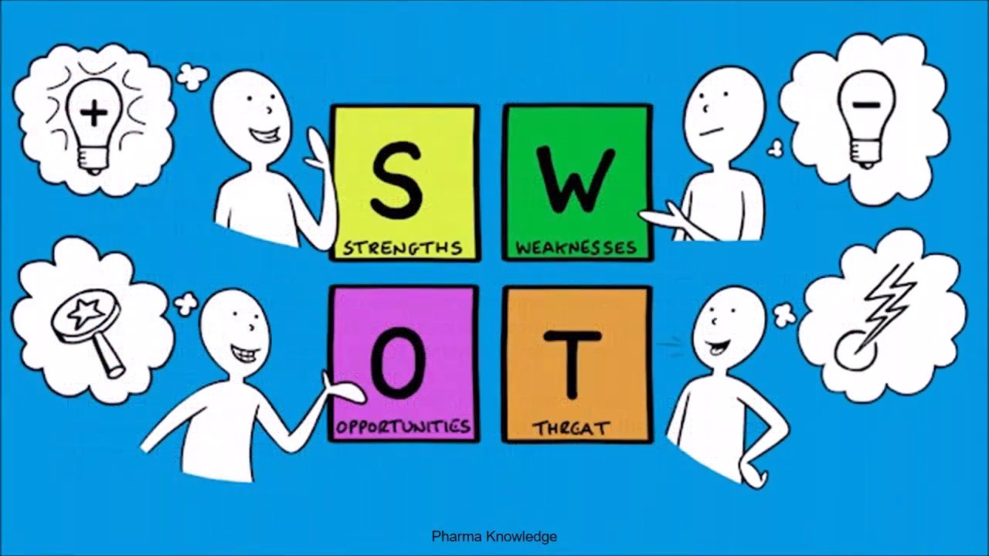
Introduction
The presentation provide an analysis of Stephens District Hospital (SDH).
SDH is located in Jefferson City, and it has the capacity of accommodating 162 inpatient cases.
SDH will attain its long term objective through examining its current threats, opportunities, weaknesses and strengths.
As the director for the radiology department, I will contribute hugely to attaining SDH's long term objectives.
Notes:
An analysis of Stephens District Hospital (SDH) is provided in this presentation to come with a strategic plan for actualizing its vision and mission. The hospital is located in Jefferson City, and it has the capacity of accommodating 162 inpatient cases. SDH will attain its long term objective through examining its current threats, opportunities, weaknesses and strengths. My roles as the director for the radiology department will be overseeing X-ray procedures, ultrasound, nuclear medicine and MRI testing. I will work towards ensuring that our departments contribute hugely to attaining SDH's long term objectives.

Slide 3
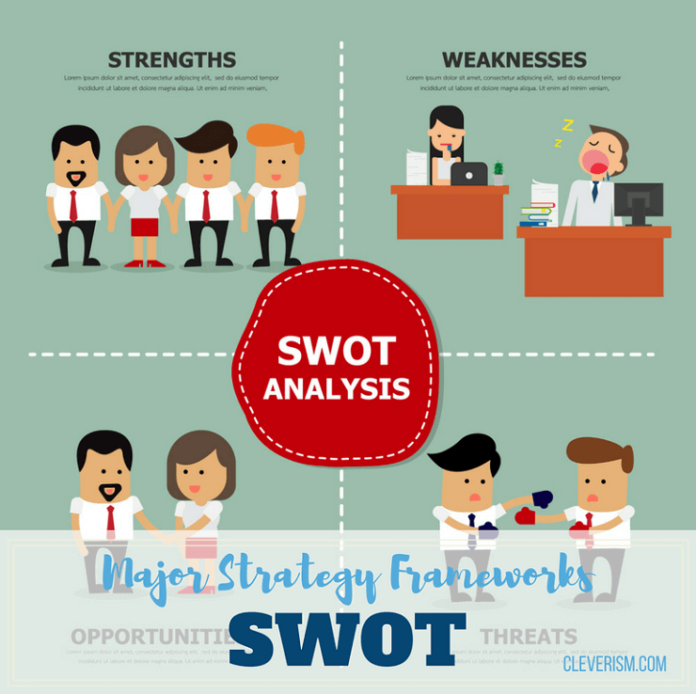
The purpose of a strategic plan
The presentation is geared towards analyzing the overall threats, weaknesses, strengths and opportunities of Stevens District Hospital (SDH).
The presentation will analyze the volume of the patients who have been visiting the hospital over the last two years to determine areas of improvement.
The strategic plan will provide a comprehensive analysis of market share analysis of SDH concerning other competitors
Notes:
The primary purpose of the strategic plan is to analyze the overall threats, weaknesses, strengths and opportunities of Stevens District Hospital (SDH). Besides, it is through analyzing the strategic plan that SDH will be able to know how the radiology department can take part in attaining hospital’s goals and visions. Another major purpose of the strategic plan is to analyze the volume of the patients who have been visiting the hospital over the last two years to determine areas of improvement. Again, the strategic plan will provide a comprehensive analysis of market share analysis of SDH concerning other competitors.

Slide 4

How a strategic plan should align with the mission and vision statements.
Improving health by providing high-quality care, a comprehensive range of services, and exceptional service is the mission for SDH.
SDH is endeavored to maintaining close ties with its affiliates to ensure the provision of outstanding healthcare service
The strategic plan will be aligned with the above mission and vision through analyzing the SDH threats, weaknesses, strengths and opportunities to have a wider view of its current progress
Notes:
Stevens District Hospital’s mission is to improve health by providing high-quality care, a comprehensive range of services, and exceptional service. When it comes to vision, SDH is endeavored to maintaining close ties with its affiliates to ensure the provision of outstanding healthcare services to both physicians and the patients. In connection, the strategic plan will be aligned with the above mission and vision through analyzing the SDH threats, weaknesses, strengths and opportunities to have a wider view of its current progress. Notably, analysis of the threats will aid radiology departments in identifying loopholes that may hinder the achievement of both vision and mission.

Slide 5
Why multiple stakeholders are important to the strategic planning process
Multiple stakeholders will be vital in improving SDH operations.
Gaining a huge understanding of specific healthcare needs will be among the benefits.
Engaging healthcare stakeholders assist significantly in knowing their individual needs better.
Multiple stakeholders provide access to advocacy assistance, thus improving policy system in addition to increasing disease awareness.
Notes:
Combining ideological perspectives and efforts of varied healthcare stakeholders will be vital in improving SDH operations. The first benefit SDH will experience after collaborating with a wide range of stakeholders is gaining a huge understanding of specific healthcare needs. Nehk (2018) suggested that engaging healthcare stakeholders assist significantly in knowing their individual needs better. Another vital importance of multiple stakeholders during decision making is having access to advocacy assistance, thus improving policy system in addition to increasing disease awareness. Notably, engaging stakeholders collaboratively will aid our department in understanding treatment processes in detail while readjusting its operation based on SDH threats, weaknesses, strengths and opportunities.

Slide 6
Importance of stakeholders that are involved in the strategic planning process
Multiple stakeholders will pave the way to a successful strategic planning process due to the sharing of skills and expertise.
Stakeholders possess varied expertise and skills, a condition that will assist SDH in gathering relevant ideas for boosting patient's care.
SDH healthcare workers will have access to consistence access to medical information and data.
SDH to collaborate with various stakeholders in a bid to secure funding and resources.
Notes:
Nehk (2018) suggested that having multiple stakeholders will pave the way to a successful strategic planning process due to the sharing of skills and expertise. Notably, various stakeholders possess varied expertise and skills, a condition that will assist SDH in gathering relevant ideas for boosting patient's care. After engaging stakeholders continuously, SDH healthcare workers will have access to consistence access to medical information and data. Importantly, it will be helpful for the SDH to collaborate with various stakeholders in a bid to secure funding and resources. Among the key stakeholders that will facilitate funding for resources is the government by giving a hand in supplying medications and insurance services.

Slide 7
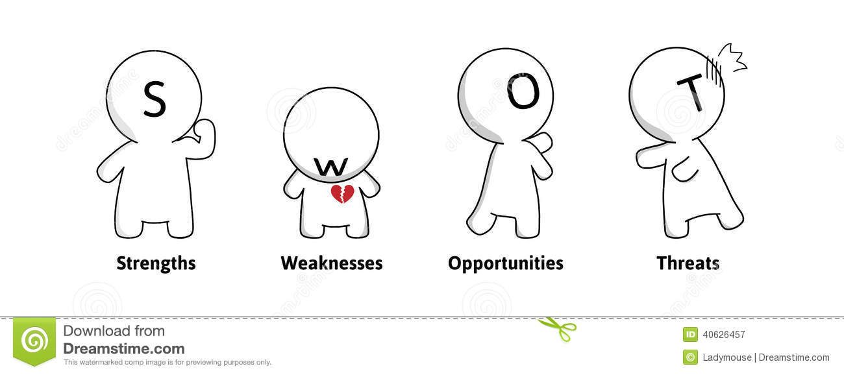
Position of stakeholders during decision-making
Patients play a huge role as stakeholders.
Patient's treatment experience with SDH will assist the decision-making committee in formulating guidelines for attaining the strategic plan.
Physicians’ opinions need to be considered during the decision-making process since they engage the patients at a personal level
Notes:
Patients are among the stakeholders who contribute greatly to making a healthcare decision. According to the University of Phoenix (2019), the patient's treatment experience with SDH will assist the decision-making committee in formulating guidelines for attaining the strategic plan. Physicians play a huge role in making a healthcare decision. University of Phoenix (2019) suggested that physician’s opinions need to be considered during the decision-making process since they engage the patients at a personal level. Besides, involving physicians in the decision-making process will aid in understanding the patient's needs and preferences.

Slide 8
Continuation
Nurses accomplish decision-making process since they act as patient advocators.
Nurse’s opinions will be highly relied on during decision making, especially in analyzing patients feedback and reactions.
Healthcare administrator’s ideas will as well be required in the decision-making process.
Healthcare administrators will be mandated to ensure that decision made are in line with ethical consideration.
Notes:
Nurses play a vital role in accomplishing decision-making process since they act as patient advocators. According to Wiley (2015), nurses are tasked with overseeing the entire treatment process, confirming that they spend much time with patients as opposed to other personnel. As such, their opinions will be highly relied on during decision making, especially in analyzing patients feedback and reactions. Healthcare administrator’s ideas will as well be required in the decision-making process to provide directives for actualizing the strategic plan. Again, healthcare administrators will be mandated to ensure that decision made are in line with ethical consideration.

Slide 9
The purpose of a communication plan
Communication process will lead to care coordination with the help of the interpersonal skills of healthcare stakeholders.
A communication process is a crucial tool for attaining an effective strategic planning process.
Communication process is the basis for making a decision, where the stakeholders follow specific steps.
Notes:
A communication process is a crucial tool for attaining an effective strategic planning process. The communication process is composed of various stages, and it is through approaching each stage, diligently that care coordination is attained in SDH. Overall, the communication process will lead to care coordination with the help of the interpersonal skills of healthcare stakeholders. Again, the communication process is the basis for making a decision, where the stakeholders follow specific steps in formulating the strategic plan for SDH. Wiley (2015) confirmed that communication process would assist the stakeholder in working fluently due to a consistent flow of ideas.

Slide 10
Continuation
Efficient management of the decision-making process will be achieved through efficient communication of all stakeholders.
The communication process will increase managerial efficiency.
Communication process creates cooperation and peace during decision making since each stakeholder’s opinion is required.
Communication process will minimize instances cohesion while formulating the strategic plan.
Communication process will boost stakeholder's morale and motivation.
Notes:
The communication process will increase managerial efficiency while putting in place a strategic plan for improving SDH operations. Efficient management of the decision-making process will be achieved through efficient communication of all stakeholders. Wiley (2015) suggested that communication process creates cooperation and peace during decision making since each stakeholder’s opinion is required based on the provided stages. As such, the communication process will minimize instances cohesion while formulating the strategic plan. The communication process will boost stakeholder's morale and motivation due to the excellent human relationship employed during the formulation of the strategic plan.

Slide 11

Conclusion
SDH operations have been deteriorating over the last five years, and the trend is anticipated to worsen.
The radiography department has formulated a strategic plan through examining SDH strengths, weaknesses, opportunities and threats.
The strategic plan will be achieved through collaboration with various stakeholders; healthcare administrators, physicians, patients and nurses.
The strategic plan is anticipated to work out perfectly if effectively applied.
Notes:
Overly, SDH operations have been deteriorating over the last five years, and the trend is anticipated to worsen if no immediate action is taken. Notably, the number of chronic diseases have been increased, a high level of readmission cases are evidence in addition to a stagnant market share. As such, the radiography department has formulated a strategic plan through examining SDH strengths, weaknesses, opportunities and threats to assist in achieving the hospital's long term objectives. The strategic plan will be achieved through collaboration with various stakeholders, including healthcare administrators, physicians, patients, nurses and government representatives. The strategic plan is anticipated to work out perfectly if effectively applied.

Slide 12
References
Nehk, K. (2018). What is Value-based healthcare? Prognosis EHR & Medical Billing. Retrieved June20, 2020, from https://prognocis.com/value-based healthcare/
University of Phoenix (2019). Strategic Planning Scenario "The Stevens District Hospital" [PDF].
Wiley Admin. (2015, February 02). The Purpose of Risk Management in Healthcare. Retrieved June 20, 2020, from https://elearning.scranton.edu/resource/business-leadership/purpose-of-risk- management-in-healthcare#:~:text=Healthcaremanagersidentiand evaluate,the damages following an event.

